Slide 1
Twitter Sentiment Analysis Project
Matthew Hill, Nathan Kaspar, Josh Soundarajan, Stephanie Carlson, Stuart Brown
Notes:
Stuart

Slide 2
What did we do?
Our project involves the use of a machine learning model to identify the emotional charge of Tweets. A Kaggle user used a Twitter API to accrue a set of 1.6 million Tweets in 2009.
Via pandas, we cleaned the data to prepare it for sklearn’s train-test split. We then used Bag Of Words and BERT to classify various keywords on whether they conveyed positive, negative, or neutral emotions.
We ran three models: a long short-term memory, RoBERT model, and two models comparing sentiment analysis with TextBlob vs. with VaderSentiment.
Notes:
Stuart

Slide 3
What did we do next?
Next we:
Reviewed the performances of the models
Refined models created to enhance their accuracy of classifying the tweets based on overall sentiment
Created a Flask application that allows users to submit tweets
Ran the model through the Flask to detect overall sentiment of these tweets
Notes:
Nathan

Slide 4
Why?
-Predicting sentiment in this manner may help future AIs in understanding what words convey a certain emotion as well as the context those words are used.
-This provides more empathetic and context aware interactions between AI and humans
-This allows AI use to be more widespread but also more ethical
We anticipate this will be especially helpful for:
Customer service feedback
Marketing
Public opinion analysis
User experience
Notes:
Nathan
Customer service feedback
Marketing opinion feedback based upon social media platforms
Public opinion for things like politics could aid campaigns

Slide 5
Models Part 1
BERT
We used a pre-trained RoBERT (Robustly optimized Bidirectional Encoder Representations from Transformers) model and tokenizer that was trained uniquely for sentiment analysis. This model was trained using 65 million tweets..
Used it to perform sentiment analysis on our original datasets tweets
Built a new dataframe to store the text, sentiment scores, and sentiment labels for BERT, TextBlob, and VaderSentiment.
Bag of Words Vectorization
Bag of Words (BoW) is a supervised machine learning model that is great at representing text data when performing Natural Language Processing (NLP). Bag of words takes a piece of text( this can be a document or a sentence) and puts it into a “bag”(matrix). BoW ignores grammar and word order and instead favors word frequency. Here’s how it does this.
Tokenization: Splits the text into individual words or tokens, it then removes punctuation and non-word.
Vectorization: each document is represented as a vector, elements in the vector are assigned a word and the value of each element is based on a count of that word in the text.
Notes:
VADER calculates a sentiment intensity score for each word in the text based on its lexicon and rules. It then combines these scores to calculate an overall sentiment score for the text. The sentiment score ranges from -1 (most negative) to +1 (most positive), with 0 indicating neutral sentiment.
Textblob uses a pattern library for sentiment analysis, weighs certain words on whether they match their pattern library and considers grammatical structure of sentences and phrases. Textblob will provide both subjectivity and polarity scores. Textblob is more pattern based and considers grammatical structure more, where vader approaches from a lexicon-based and focuses on the sentiment intesitey of individual words.

Slide 6
Models Part 2
VaderSentiment
Analysis tool used primarily for sentiment expressed in social media but also works for other domains that have text. It’s a popular tool to determine sentiment polarity (Ex: Positive, negative, or neutral) and is very usle for analyzing short texts like tweets, comments or reviews.
Vader uses a lexicon and rule-based approach. Much of Vaders lexicon and sentiment score were manually labeled by human annotators. For vader each word is assigned a sentiment score which indicates how positive negative and neutral it is.
TextBlobs
An open-source Python library for processing textual data. It can be used for detecting patterns in text, parts of speech tagging as well as sentiment analysis. It is most commonly used in NLP tasks.
TextBlob focuses on tokenization, part-of-speech tagging, noun phrase extraction, sentiment analysis, and more.
TextBlob uses a polarity based score. It does this by placing float values on specific phrases and sentence structure to gauge subjectivity or polarity. The Polarity score falls between [-1.0, 1.0] a polarity greater than 0.0 is considered positive, and a polarity less than 0.0 is considered negative. If the polarity is 0.0 its neutral.
Notes:
Textblob uses a pattern library for sentiment analysis, weighs certain words on whether they match their pattern library and considers grammatical structure of sentences and phrases. Textblob will provide both subjectivity and polarity scores. Textblob is more pattern based and considers grammatical structure more, where vader approaches from a lexicon-based and focuses on the sentiment intesitey of individual words.

Slide 7
Overview of Data
1.6M Tweets, all from 2009
660,000 Unique Users
Original Targets Split 50% 50% Positive/Negative

Slide 8
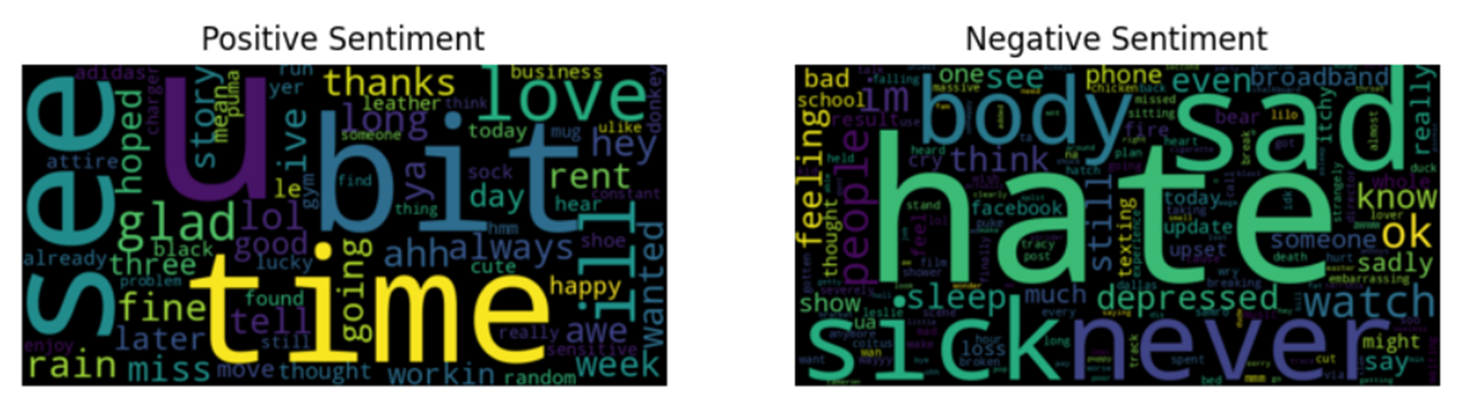
Word Cloud of Tweets

Slide 9
Original Results Pre Text Cleaning - Bag of Words
VaderSentiment
Accuracy Score: 0.74526
Precision: 0.7472790617727212
Recall: 0.74526
F1 Score: 0.7392229063283018
TextBlobs
Accuracy Score: 0.755655
Precision: 0.7634987820490563
Recall: 0.755655
F1 Score: 0.7378697866638233
Notes:
Matt/Stephanie

Slide 10
Results after Cleaning - Bag of Words
VaderSentiment
Accuracy Score: 0.8470225
Precision: 0.8507783927062014
Recall: 0.8470225
F1 Score: 0.8459390728898293
TextBlobs
Accuracy Score: 0.856185
Precision: 0.8598559899324191
Recall: 0.856185
F1 Score: 0.8533827640080314
Original Data Targets
Accuracy Score: 0.7342025
Precision: 0.7345913371141636
Recall: 0.7342025
F1 Score: 0.7340973573064117
Notes:
Matt/Stephanie

Slide 11
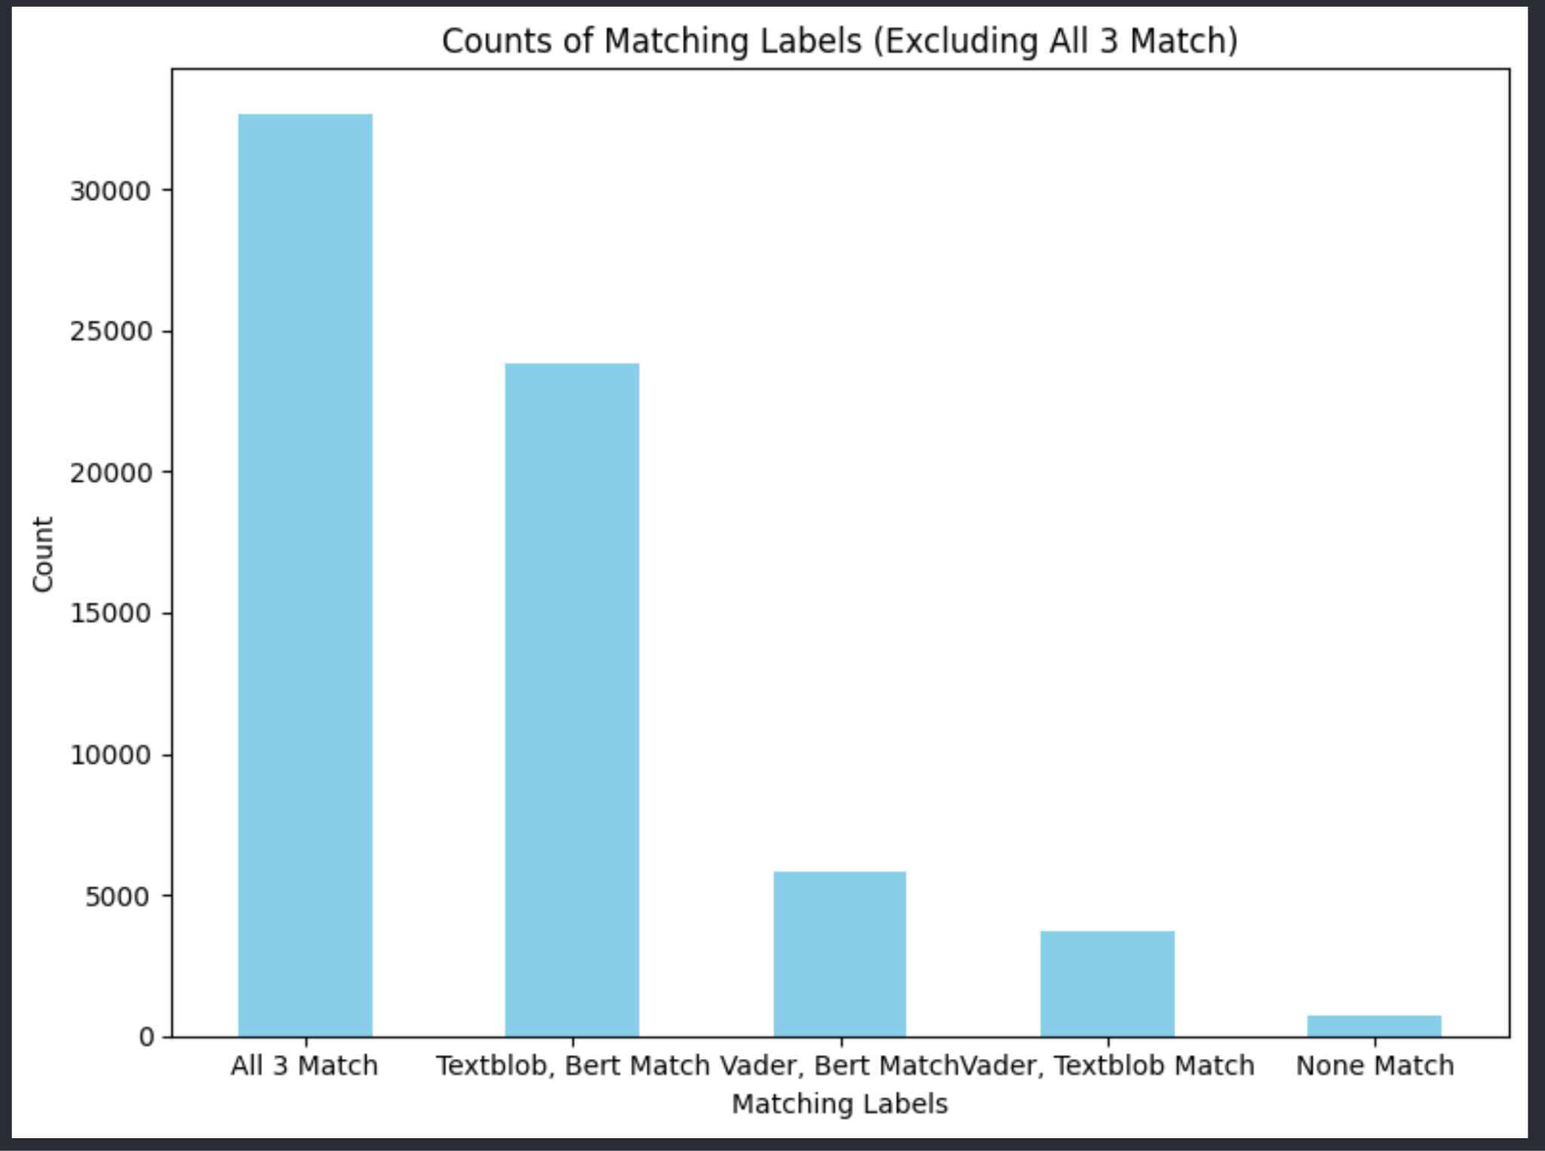
Comparing BERT, Vader, and Textblob
We did a test with 66,000 tweets, 50% of the time the models all identified the same sentiment. After that, TextBlob and BERT were the most similar models matching 36% of the time
Notes:
Matt

Slide 12
Demo
A demonstration of the RoBERT model through a Flask application
Steps
User inputs a sentence in the search bar and clicks the analyze button
The application outputs the sentiment class
0 = Negative
1 = Neutral
2 = Positive
It also produces the sentiment scores (model’s confidence for each class)
Notes:
Josh
In the Flask App we:
Load the sentiment analysis model and tokenizer from the hugging face transformers library
Built a route labeled /analyze, and within that we extract the user sentence submitted in the homepage
The Flask lists the sentiment label from 0 to 2. Indicating 0 as the negative class and 2 as the positive class

Slide 13
Challenges and Future Updates
Challenges:
Finding a data source, we originally looked at a different topic but couldn’t find a big enough dataset for it
When we decided on a sentiment analysis, we tried the Twitter API and found it wouldn’t have given us enough data. We then searched Kaggle and were able to find a datasource of Tweets
Future Updates:
Use a more recent dataset, as ours was from 2009
Incorporate analysis on current social media posts
Notes:
Stephanie

Slide 14
Citations and sources
Original data: https://www.kaggle.com/datasets/kazanova/sentiment140
Thanks to Kazanova, aka Μαριος Μιχαηλιδης (Marios Michailidis), for his undertaking.
Thanks to cjhutto for authoring VaderSentiment and Analytics Vidhya for their instructions on how to deploy it.
Thanks to Steven Loria and his team for authoring TextBlob.
Thanks to tensorflow, pandas, and Python for their code.
And thank you all for your time!
Notes:
Stuart

Slide 15
Thank you!
Notes:
Stuart will answer any fielded questions.

